Slide 1


Slide 2
Data Description
1. Order Id
The Order ID is the id given to the order
2. Order date
The order date is the date when the product is ordered
3. Region
The region in which the customer stays
4. Country
The country in which the customer reside

Slide 3
Data Description
5. Item Type
item type is the varieties if item sales in the amazon
6. Sales Channel
Mode of shopping Online or Offline
7. Order Priority
Priority of sales range between low to high
8. Ship Date
Ship date is when the product is dispatched

Slide 4
Data Description
9. Unit Sold
Number of unit sold per product
10. Unit Price
Selling Price of the Product
11. Unit Cost
Cost of the Product
12. Total Revenue
Total Sales of the company

Slide 5
Data Description
13. Total Cost
Total Cost of the company
14. Total Profit
Total profit Earned by the company

Slide 6
Insights
KPIS
PROFIT WISE ANALYSIS
REVENUE WISE ANALYSIS
ORDER WISE ANALYSIS

Slide 7
KPIS
44.17M
Total Profit
137.35M
Total Revenue
93.18M
Total Cost
513k
Unit Sold

Slide 8
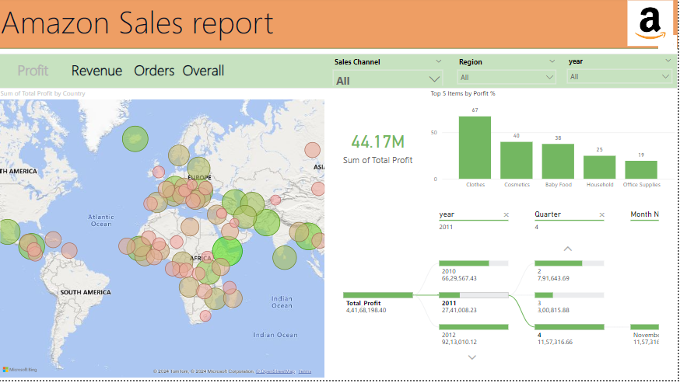
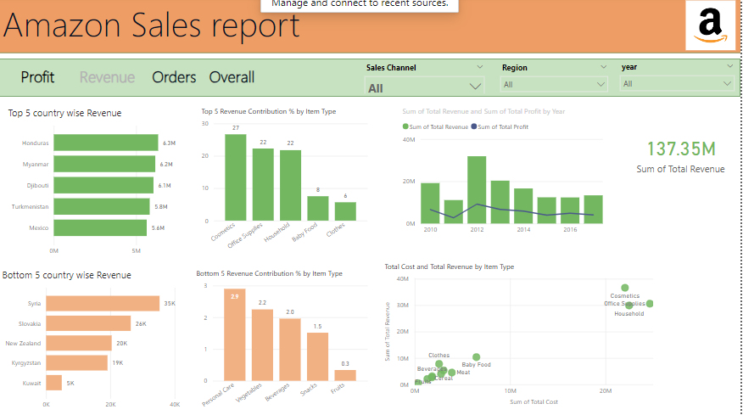
My Designs

Slide 9
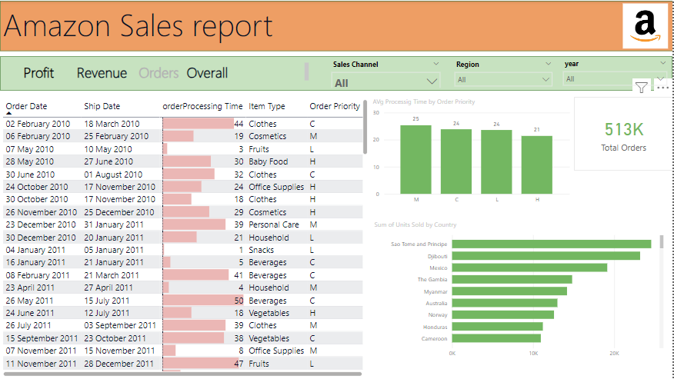
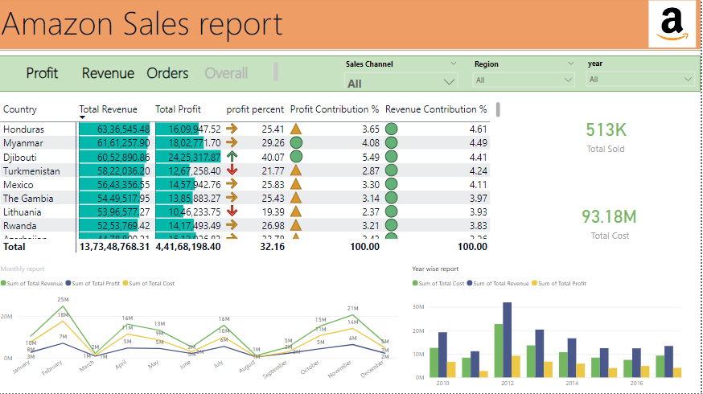
My Designs

Slide 10
THANK YOU

